Slide 1
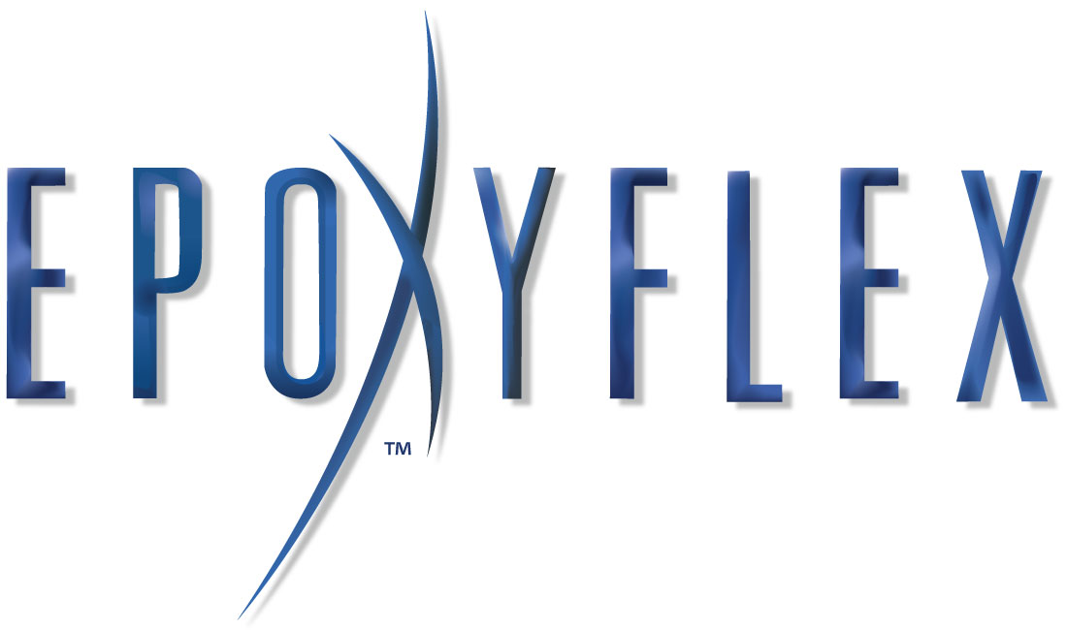
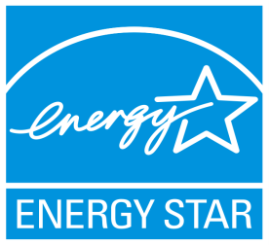
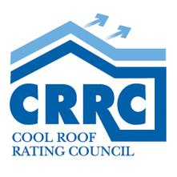
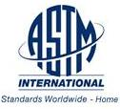
Presents:

Slide 2
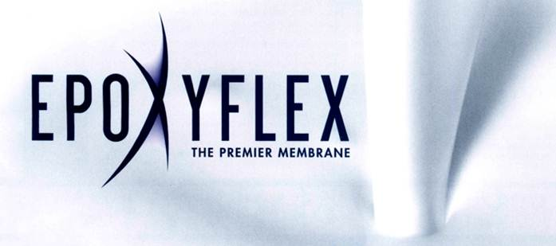
What is EpoxyFlex?
EpoxyFlex is molecularly engineered substance which is a protective coating that can be applied to multiple surfaces. In simpler terms, it is a great coating that can replace paint, go over paint, water proof, protect against the heat and eliminate maintenance!

Slide 3
Why EpoxyFlex?
EpoxyFlex's maintenance membrane acts as a vapor and thermal barrier, and can be used to enhance, protect, and improve bridged expansion gaps, as a concrete coating in above- and below-grade applications, and as a stucco color coat.
EpoxyFlex is impenetrable by certain bacteria, moss, molds, algae, rust, chemicals, UV radiation, animal fats, acids and seawater.
Since EpoxyFlex has superior adhesion properties, it will permanently adhere to almost any surface and is perfect for commercial, industrial, or residential use.

Slide 4
EpoxyFlex is Environmentally Friendly!
EpoxyFlex is a non-toxic, non-carcinogenic, water-based coating
In manufacturing EpoxyFlex, there are NO significant quantities of waste. Manufacturing of the product and the application process are non-energy intensive.
Implementation of EpoxyFlex's maintenance program reduces weathered, depleted, and discarded materials generally returned to our environment (landfills) as remodeling waste.
Studies also show that utilizing EpoxyFlex may reduce the polluting effect of Urban Heat Islands

Slide 5
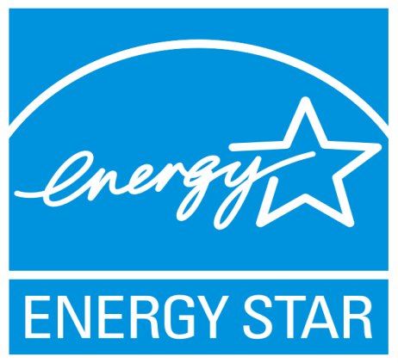
Compliant With:
Miami-Dade County Standards
Cool Roof Rating Council
Energy Star Standards
California Title 24
U.S.G.B.C. Leed
ASTM Standards

Slide 6
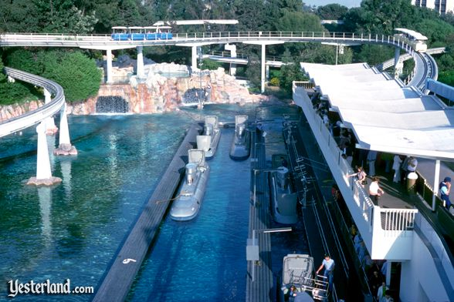
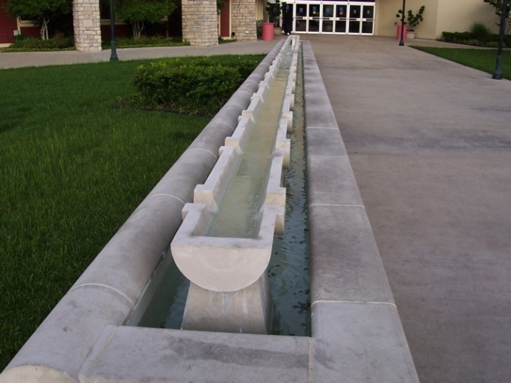
Where Can EpoxyFlex Be Applied?
EpoxyFlex may be used wherever a permanent elastomeric coating is desired. Some examples include, but are not limited to:
Water –Related Applications:
Fountains
Boat Decks and Hulls
Theme Park Rides (Submerged Equipment)
Swimming Pools and Decks
Metal Struts (Parking Lots/Bridges)
Concrete Structures (Water Tanks)
Concrete Piers in Salt Water
Building Uses:
Decks
Metal/Aluminum/Tile Roofs
Concrete/Stucco Exterior
Other Uses:
Submarines
Freight Containers
Airplanes
RVs
etc.

Slide 7
Example of Water Ride
One major theme park in California utilized EpoxyFlex to successfully coat and protect their submarine ride for 15 years!

Slide 8
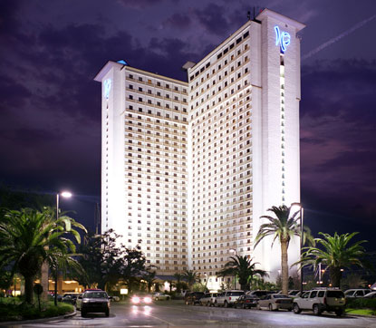
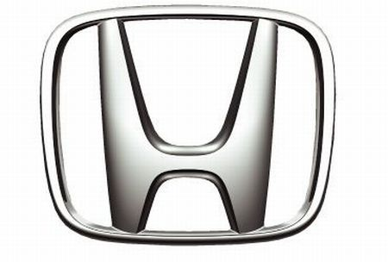
Who Has Used EpoxyFlex?
Our Product has been in use for over 32 years, without a single product failure, and used on thousands of buildings.
Our Clientele include, but are not limited to the following:
Major Theme Parks
US Government
US Military
Camping World
Coors Light
Imperial Palace, Biloxi MS
Dallas Trucking Depot
Honda Assembly Plant in Ohio
Scott Electric Company

Slide 9
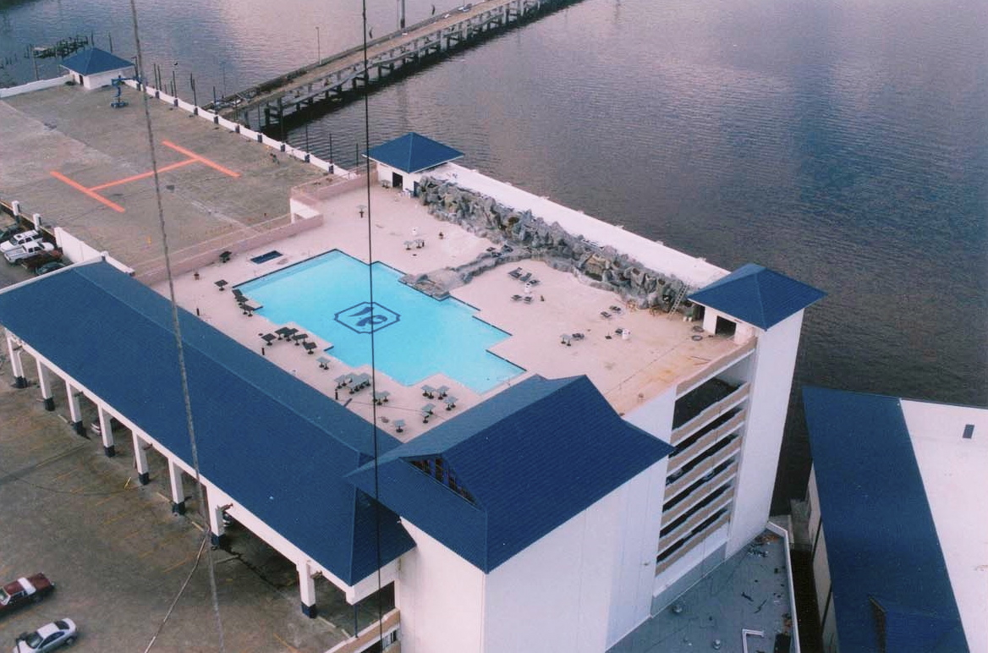
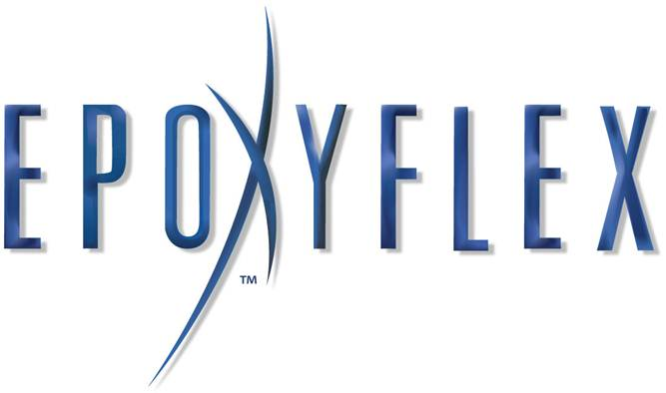
Imperial Palace-Pool Deck
Roof and pool deck of Imperial Palace in Biloxi, MS
Damaged by Hurricane Katrina, 2005
EpoxyFlex repaired roof and deck damage in record time
Casino was one of the first to reopen before the end of 2005

Slide 10
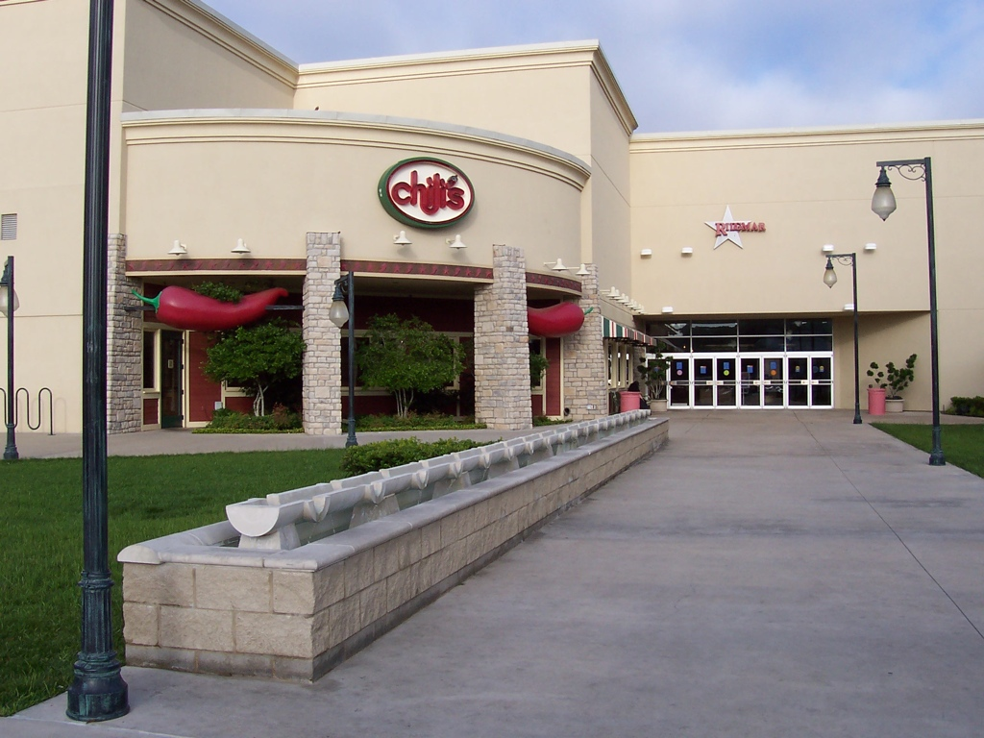
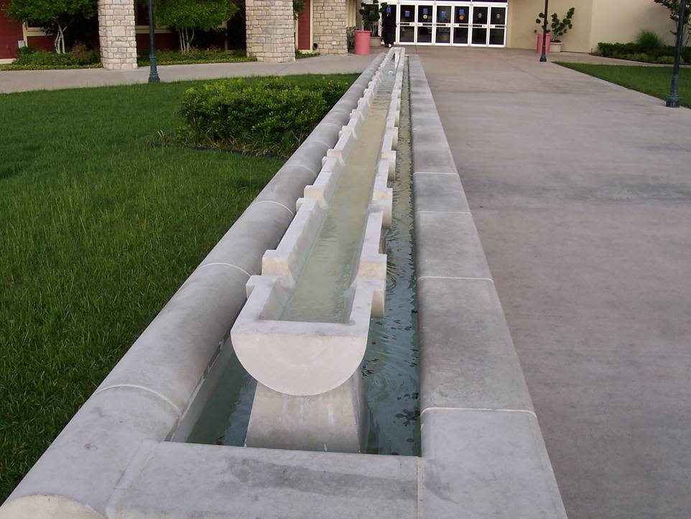
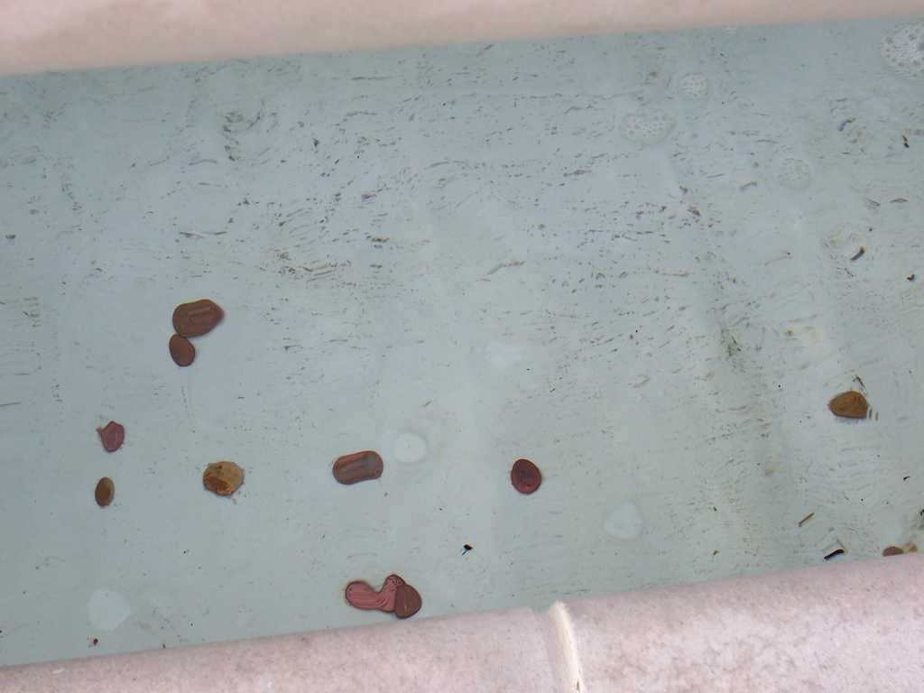
Mall Fountain in Texas
Protect prominent fountain at pedestrian shopping center
Helped stop leaks in fountain

Slide 11
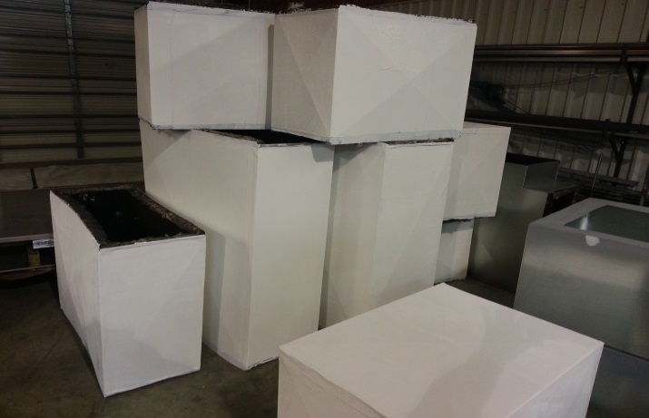
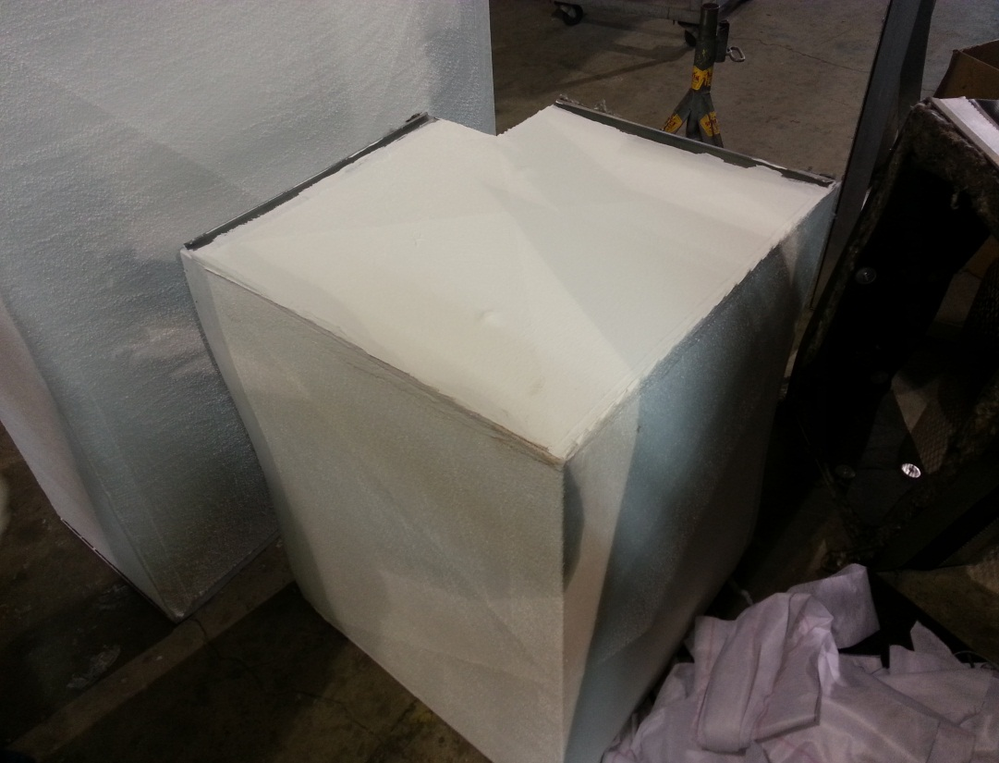
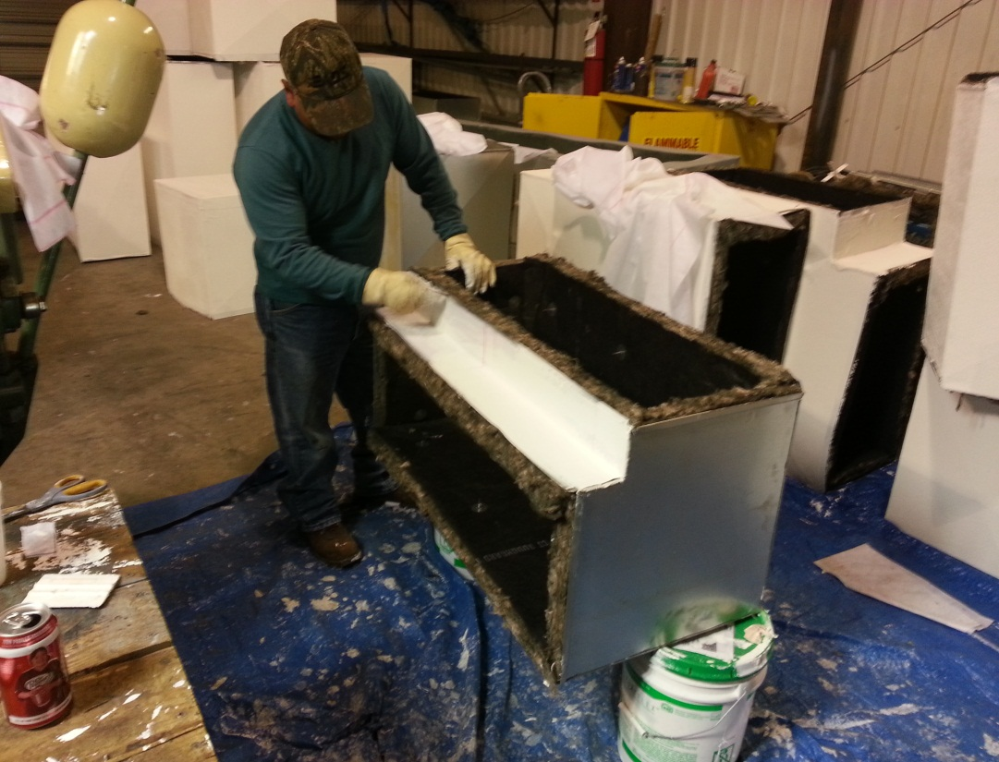
HVAC Protection
Protect HVAC duct work from: Heat, Water, UV deterioration and Leaks.

Slide 12
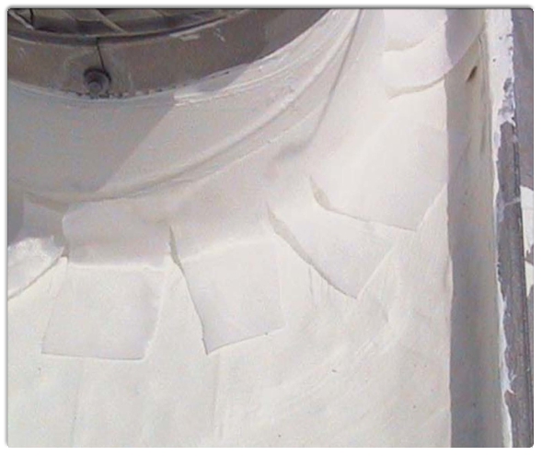
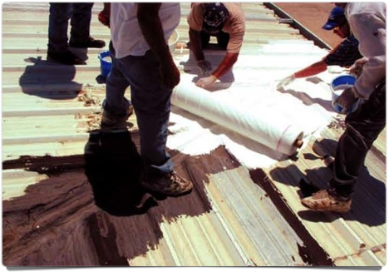
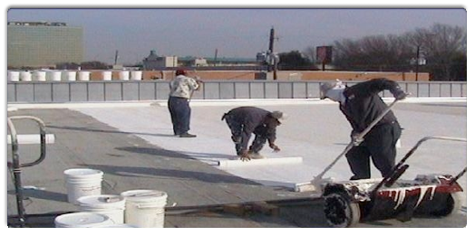
Application Process
The application is a simple install compared to any other similar product on the market. The material comes in a liquid form and can be rolled or sprayed onto the surface. If it is going to be applied to a roof, or to act as the top of a roof instead of using a product such as EPDM, you would utilize WeaveFlex on seams and protrusions for added strength and then apply the appropriate amount of the EpoxyFlex coating to achieve the thickness desired.

Slide 13
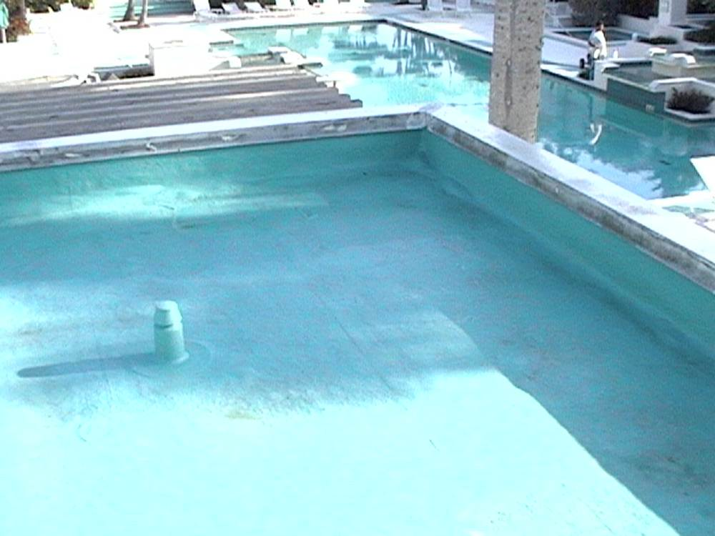
Advantages of EpoxyFlex
The advantages of EpoxyFlex are incredible. Below we have created a list including but not limited to:
Resisting Heat of Up to 400 Degrees
Resisting Cold of -65 degrees
Saves up to 30% on Energy Bill
Contracts and expands with temperature
Consistent Reflectivity
Consistent Insulation & Energy Savings
Never cracks, chips, or peels
Withstands severe hail, fire and flooding
Immune to Ponding Water
Unaffected by Grease, Animal Fats, Oils and Acids

Slide 14
Warranty Features

Slide 15
Warranty Terms
Life-Time Manufacturer's Material Warranty
Application Warranties Available:
10-Year NON PRORATED
15-Year Extended NON PRORATED
Touch-Up Every 10 Years to Extend!
EpoxyFlex has been lab tested to last 50 years, however since most underlayments haven’t, we offer the above non-prorated warranties.

Slide 16
Adhesion & Chemical/ Electrical Resistance
Adhesion - 331.psi. No loss of Adhesion with Bending (ATSM D-4145-83) - Meets or Exceeds Miami-Dade County Standards
Chemical Resistance - No effect, including Salt Water. 24 hrs. in 30% HCl and 18 hrs. 30% H2SO4 with No effect. (AAMA 605.3-92) Also includes exposure to 30% H2SO4 and HNO3 Fumes
Electrical Resistance - 15,000 Megohms per cm2

Slide 17
Stands Up to Water
Water Immersion Resistance
Immersed in distilled water at 100℉ 3,000 hours (ASTM D-870-92). No loss of gloss, no color change, no cracking or blistering (ASTM D-714- 87)
Water Vapor Permeability
0.031 perms @ 24 mils g/hr/m2 (ASTM D-1653 and ASTM E-96)

Slide 18
Factory Capabilities
We Can Ship to Any of the 48 Contiguous States Within 24 Hours
We Can Manufacture 200K+ Gallons Per Month
Just-in-Time Manufacturing
Shipped in 1 & 5-Gal. Pails, 55-Gal. Drums or 360-Gal. Totes

